Slide 1
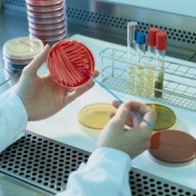
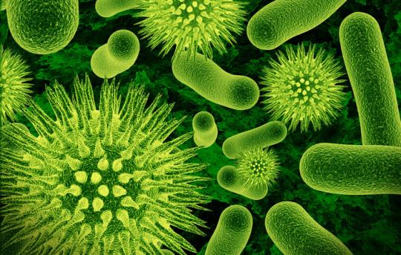
MICROBIOLOGY
Introduction and Scope
Mamita Rai Gurung
Microbiologist

Slide 2
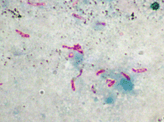
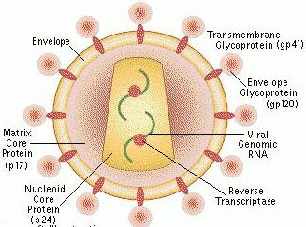
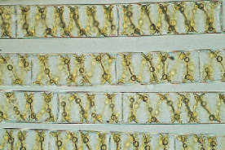
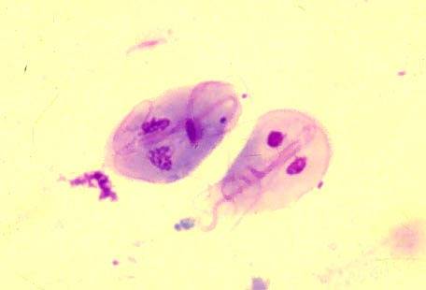
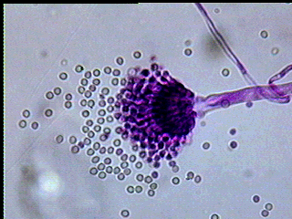
Introduction
Mikros- small, bios- life, logus- study
Microbiology is the study of microorganisms usually less than 1mm in diameter which requires some form of magnification to be seen clearly
  Examples:
    Viruses
    Bacteria
    Fungi
    Algae
    Protozoans

Slide 3
Introduction
study of all aspects of microorganisms ; their form, structure, reproduction, physiology, metabolism and classification.
Include study of their distribution in nature, their relationship, effect on living things, abilities to make changes in environment.
Microorganisms are beneficial as well as detrimental.
Application of microorganisms in various fields including medicine, agriculture, industries, biotechnology, environment etc.
It is not only concerned with the disease but also they are predominantly important for humans.
Microorganisms include the organisms of microscopic size which include bacteria, fungi, algae, protozoa and the infectious agents at the borderline of life that are called viruses.
Antony Van Leewenhoek (1673 AD) first observed life by microscope (father of microbiology)

Slide 4
Characteristics of microorganisms
Microorganisms are too small to be seen with naked eyes, only observed through the microscope
Microorganisms can exist alone in nature
Are found everywhere i.e. in air, water, land
Are beneficial as well as harmful to human beings
Some microbes cause human disease
Microbes deteriorate the materials like iron, pipes, glass and food.

Slide 5
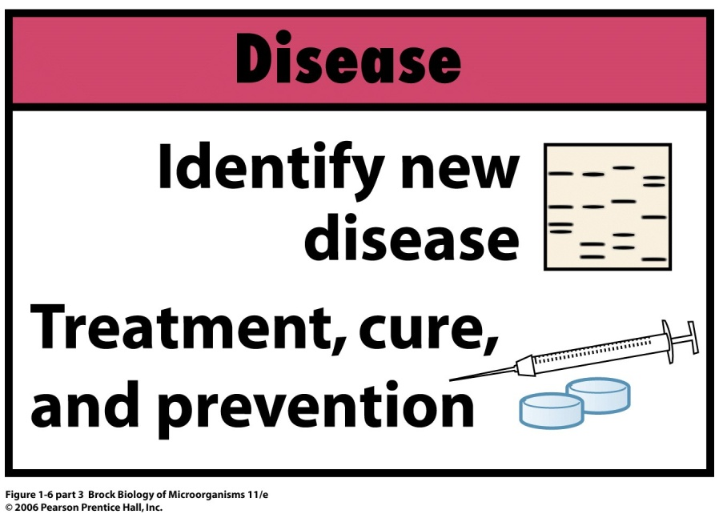
Scopes/ Areas of microbiology
Medical Microbiology: deals
with causative agents of disease,
diagnostic procedure for
identification of caussative agents
and preventive measures.It also
deals sometimes with tracking down
new unidentified pathogens, mechanism of infection etc.
Public Health Microbiology: related to medical microbiology however it deals to control spread of communicable diseases. It also deals with monitoring community food establishments and water supplies to keep them safe and free from infectious disease agents

Slide 6
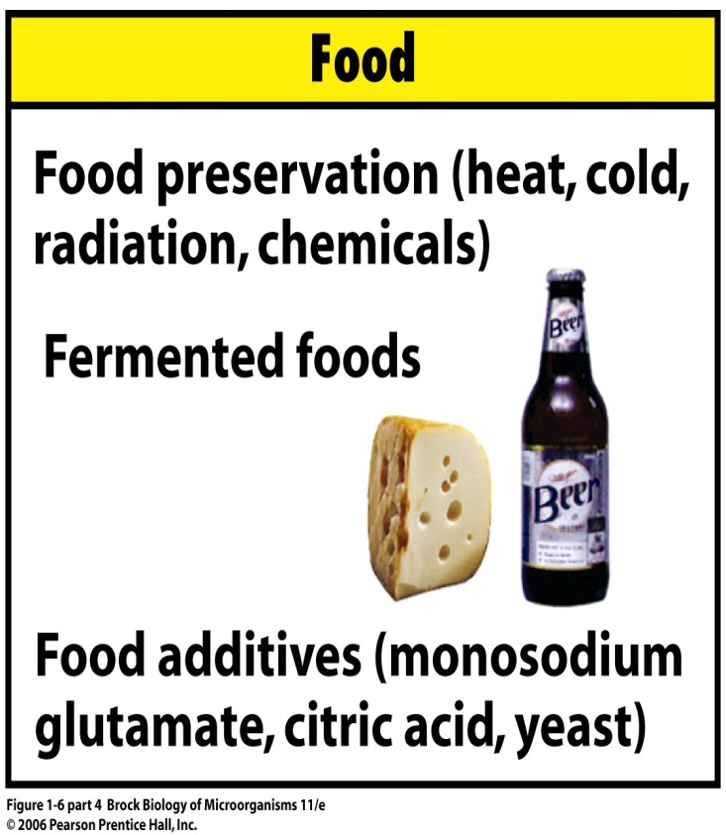
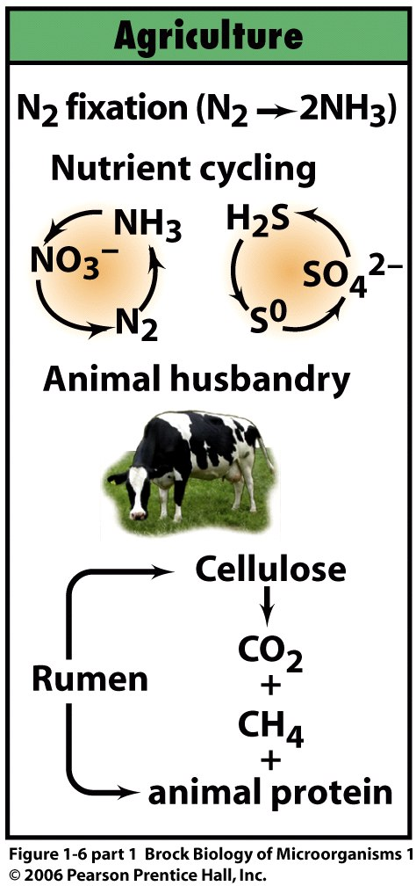
Food Microbiology: deals to
prevent microbial spoilage of
food and transmission of food
borne diseases like botulism and
salmonellosis. It also deals with
the use of microbes to make
foods such as cheese, yoghurts,
pickles and beer.
Agricultural Microbiology:
concerned with impact of micro-
organisms on agriculture like
combating plant disease,
increase soil fertility and crop
yield, biopesticides etc.

Slide 7
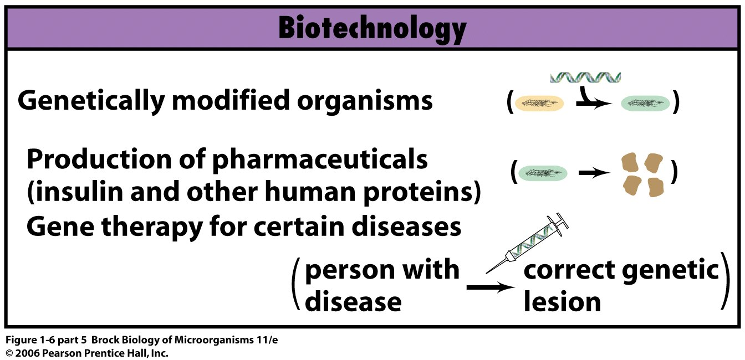
Industrial Microbiology: deals with use of microbes to make products such as antibiotics, vaccines, steroides, alcohols, vitamins, aminoacids, sugars etc. It is also important in bioleeching.
Microbial ecology:
deals with relationships
between microbes and
their living and non
living habitat. It deals with contribution of
microbes in C, N, S cycle in soil and
freshwater.It is also important in bioremediation.

Slide 8
History
The history of microbiology can be divided into
early discoveries,
golden era of microbiology,
era of chemotherapy and microbial genetics and
the modern molecular biology era.

Slide 9
Early discoveries
The existence of microbes was not known until the discovery of microscopes.
Discovery of microorganisms made by Antony Van Leeuwenhoek in 1675 was considered to be a starting point for microbiology.
The existence of microbes was not known until the discovery of microscopes
He described the “very little animalcules” which is recognized as free living protozoa
He described three morphological forms of animalcules-rod, sphere and spiral forms
To Leewenhoek animalcules were curiosities of nature and their role in disease was not realized
Later the scientist community of the time became interested in the origins of these tiny living things.

Slide 10
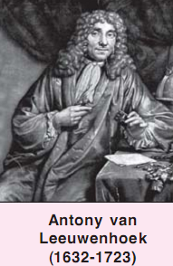
Contribution of Antony van Leeuwenhoek
He first observed and reported bacteria.
He observed microscopic structure of seeds and embryos of plants and some invertebrate animals.
He discovered Spermatozoa, RBC.
He described characteristic microflora of human mouth, curd, vinegar.
He also emphasized the abundance of these microorganisms besides their great diversity.

Slide 11
Golden age of microbiology
(1854-1914)
The golden era of microbiology began with brilliant experiments of Louis Pasteur, Robert Koch, John Tyndall, Elie Metchnikoff and others.
The majority of the microbial discoveries, their scientific principles and advancement were made during this period of time.
These paved the way for development of microbiology as a very important branch of science.

Slide 12
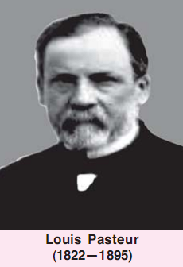
Contribution of Louis Pasteur
Disproved the theory
of spontaneous generation.
Developed vaccines against
rabies, anthrax and cholera.
Devised the process of
destroying bacteria-pasteurization.
Established germ theory of disease.
Showed that fermentations are due to microorganisms.

Slide 13
The credit for earliest discovery of pathogenic roles of microbes goes to Augustino Von Bassi, who proved disease of silkworm, muscardine was caused by fungus.

Slide 14
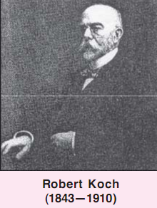
Contribution of Robert Koch
Verified germ theory of disease.
Gave Koch’s postulates.
developed solid culture media
and the methods for studying
bacteria in pure cultures
Discovered methods for staining bacteria
Isolated Vibrio cholerae, the cause of cholera and Mycobacterium tuberculosis

Slide 15
Era of chemotheraphy and microbial genetics (1943-1970)
In this era many groups of antibiotics were discovered.
Similarly electron microscope reveled bacteria as procaryotes as they lack a cell nucleus.
This era brought molecular genetics to biology due to which genetic materials of organisms, their nature and regulation were studied.

Slide 16
Some scientists, their contributions.
Gerhard Hansen observed bacteria in leprosy patients.
Joseph lister developed principle of antiseptic surgery.
Friedrich Loeffler isolated diptheria bacillus.
Metchnikoff described phagocytosis.
Albert Calmette developed immunisation process for tuberculosis.
Ronald Ross showed that mosquitoes can transmit malaria.

Slide 17
Paul Ehrlich synthesized the 1st chemical (Salvarsan) that destroys pathogen of syphilis.
Alexander Fleming discovered penicillin.
Selman Walksman discovered actinomycin and streptomycin and coined the term antibiotics.
Electron microscope was developed which classified bacteria as procaryotes.

Slide 18
Modern molecular biology Era
In this era, it was possible to manipulate genetic material of living organisms which lead to the development of biotechnology.
Manipulation of microorganisms by genetic engineering led the microbes to produce human proteins like insulin or growth factor, synthetic vaccines like Hepatitis B vaccine.

Slide 20
Spontaneous generation theory
Spontaneous generation (Theory of Abiogenesis)- living animalcules are formed spontaneously from nonliving matter.
(Theory of Biogenesis)- living animalcules are formed from the ‘seeds’ or ‘germs’ of these animalcules which are always present in the air.
Later, due to increased knowledge of living organisms, abiogenesis gradually lost its acceptance.

Slide 21
Until the second half of 19th century, scientists believed that some forms of life could arrive spontaneously from non living matter, they called these hypothetical process the spontaneous generation (abiogenesis).
At that time, people believed that toads, snake and mice could be born from moist soil, flies from manure and maggots from decaying process.
Aristotle– Believed that simple invertebrates could arise by spontaneous generation
A strong opponent of spontaneous generation was given by Francesco Redi in 1668. he performed Jar experiment and established the fact that origin of maggots was the flies and not meat.
Needham showed that microbes developed in closed flasks of previously heated putrescible fluid(mutton gravy) but Spallanzani found no such generation of microorganism after long heating of fluids and proved microorganisms were carried in air in Needhams experiment.

Slide 22
These arguments were settled down by Louis Pasteur by his Swan neck experiment.
Pasteur first filtered air through sterile cotton and then the sterile cotton was placed in a sterile medium. This showed the growth of microorganisms and indicated that air contained these microorganisms.
Later, he poured sterile nutrient medium in specially designed flasks called swan-necked flasks. He then boiled the medium to free the contamination and allowed to cool. In this, growth was not observed even though the curved necks had opening to surrounding atmosphere.
Pasteur thus opined that no growth was seen because dust and germs had been trapped by the walls of the curved necks. But, growth would be noticed if the curved necks were broken because the air could enter directly into the flasks with depositing the germs and dust on the neck walls.

Slide 23
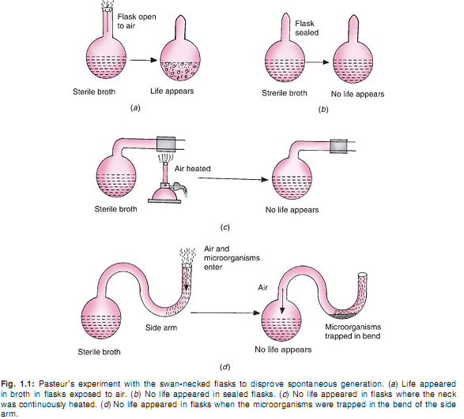

Slide 24
Germ Theory of disease
Theory that proposes microorganisms are the cause of many diseases.
Before 19th century it was controversial.
Validated in 19th century by several scientists including Robert Koch and his Koch’s postulates
After 19th century, it became the cornerstone of modern medicine and clinical microbiology.

Slide 25
Supporters of germ theory.........
Agostino Bassi (1773-1856) demonstrated that silkworm disease was due to fungal infection-first showed that a microbe could cause disease.
Louis Pasteur demonstrated that pebrine disease of silkworm was due to protozoan parasite, a microbe.
Joseph lister developed antiseptic surgery-this not only killed bacteria but also prevented wound infection.
Robert Koch- 1st to show that bacteria cause disease from his study on anthrax-Koch postulate.

Slide 26
Koch’s Postulates
Microorganisms must be present in every case of disease but absent from healthy organisms.
The suspected microorganisms must be isolated from the diseased host and grown in pure culture.
When the isolated microorganisms is inoculated into a healthy host, it must produce the same disease.
The same microorganisms must be isolated from the diseased host.

Slide 27
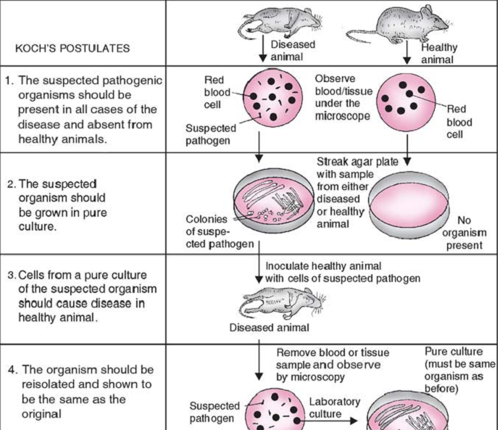

Slide 28
Future......challenges
Respond to continuously arising old or unknown diseases like AIDS, tuberculosis.
Stop established diseases like antibiotic resistance, MDR.
Minimize bioterroism.
develop new isolation techniques and an adequate classification of microorganisms, one which includes those microbes that cannot be cultivated in the laboratory.
Much more........

